Slide 2
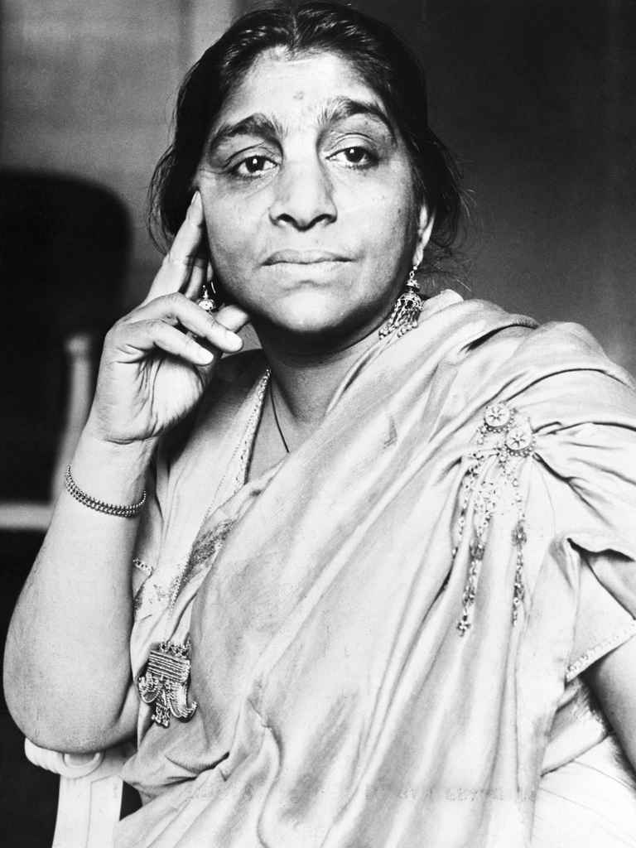
Who is she?

Slide 3
Summary
The palanquin bearers are carrying a royal bride in a palanquin. They are singing a song while moving. The song is related to the bride. They say that they are bearing the bride lightly. The bride is swaying like a flower in the wind.
She is gliding like a bird on the froth of a stream. She is floating quietly like a laugh from the lips of dream. They are singing and carrying her happily. They are carrying her like a pearl on a string.
They are moving gently and cheerfully. She is hanging like a star in the dew of their song. She rises like a ray of light seen on the top of a tide. She falls like a tear from the eyes of a bride.

Slide 4
Simile It is a figure of speech which directly compares two things. Words such as 'like', 'as', are used to convey the comparison.
We bear her along like a pearl on a string.
She falls like a tear
She springs like a beam
She hangs like a star
She sways like a flower
She skims like a bird
She floats like a laugh

Slide 5
Alliteration Repetition of sounds in a series of words to create a poetic effect
She sways like a flower in the wind of our song.
She skims like a bird on the foam of a stream.
She floats like a laugh from the lips of a dream.
Gaily ,O gaily we glide and we sing
She springs like a beam on the brow of the tide.

Slide 6
Answer the following
1. Pick out the words from the poem that describe the movement of the bride.
sway, skim, float, spring, glide
2. How do the palanquin bearers carry the bride?
The palanquin bearers carry the bride smoothly and carefully.
3. Why do the palanquin bearers carry the bride lightly?
The palanquin bearers do not wish to hurt the bride by carrying her roughly. Hence, they carry her carefully and lightly.
4. How do the palanquin bearers feel when they carry the bride?
The palanquin bearers feel very happy and proud to carry the bride. They sing songs and move along.
5. Why is the bride compared to a flower and a bird?
The bride is as beautiful as a flower and as light as a bird. She is very delicate and hence is compared to a flower and bird.

Slide 7
Answer the following
6. Why is the bride referred to as ‘a pearl on a string’?
The bride is as precious as a pearl on a string.
7. Why is the bride compared to a star?
The bride looks as bright as a star. Like a bright star she is the center of attraction.
8. Which two emotions of the bride does the poetess mention in the poem? Why?
The poetess mentions two contradictory feelings; happiness in the first stanza and sadness in the third stanza. In the beginning, the bride is happy as she is going to her husband’s house to begin a new life and in the end, she is sad because she is going away from her parents.
9. The poetess uses a lot of similes. Why do you think the poetess uses them in the poem?
The poetess uses simile in the poem to emphasise on the beauty and the emotions of the bride.

